Slide 1
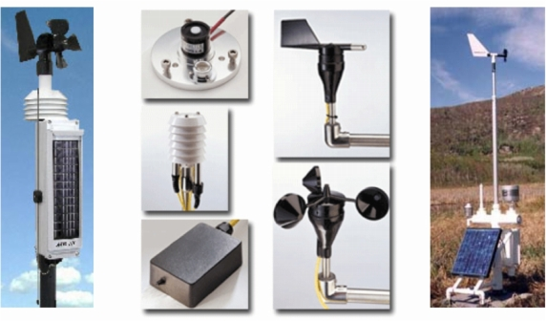
Weather Instruments

Slide 2
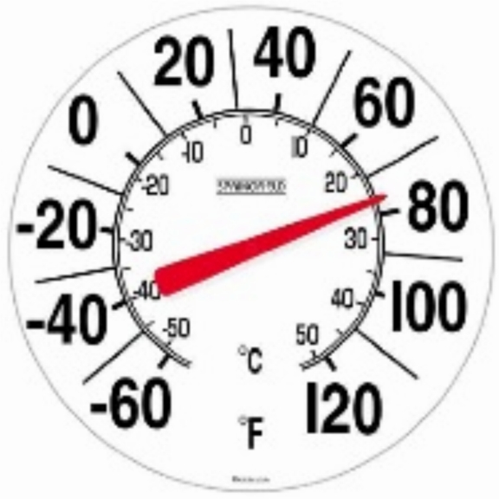
A Thermometer measures air temperature.
A Thermometer works because matter expands when heated. Most thermometers are closed glass tubes containing liquids such as alcohol. When air around the tube heats the liquid, the liquid expands and moves up the tube. A scale then shows the actual temperature of the air.

Slide 3
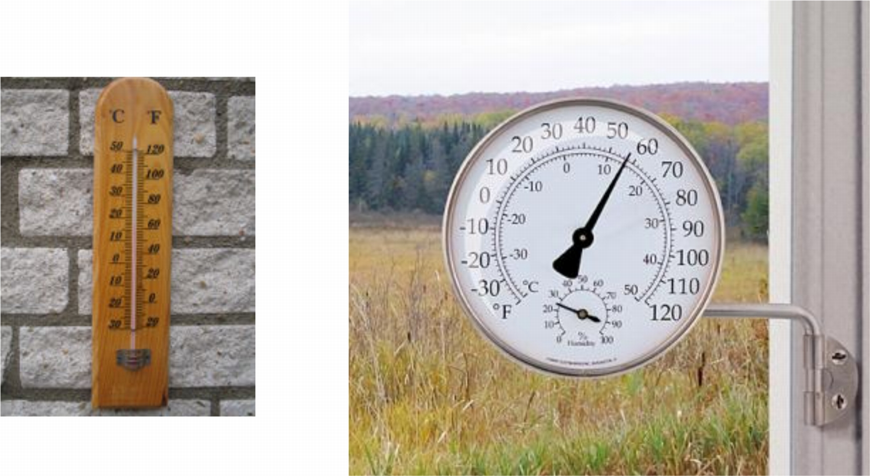
Thermometers
This also has a Hygrometer,
which measures humidity.

Slide 4
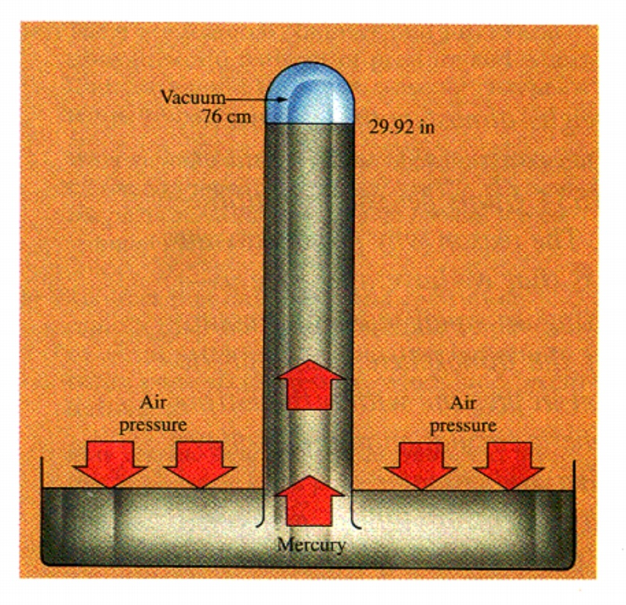
A Barometer measures air pressure.
An Italian scientist named Torricelli built the first barometer in 1643. People still use barometers based on Torricelli's design to measure air pressure.

Slide 5
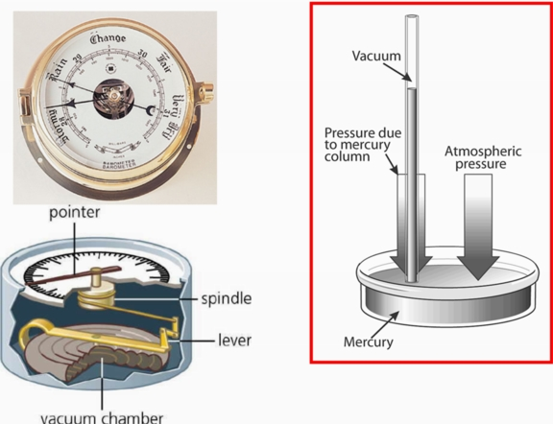
Barometers
Torricelli’s Barometer

Slide 6
A Psychrometer measures relative humidity.
Two thermometers are used in a Psychrometer. A wet cloth covers the end of one of the thermometers. Water evaporates from this cloth, causing the temperature on that thermometer to be different from the other.

Slide 7
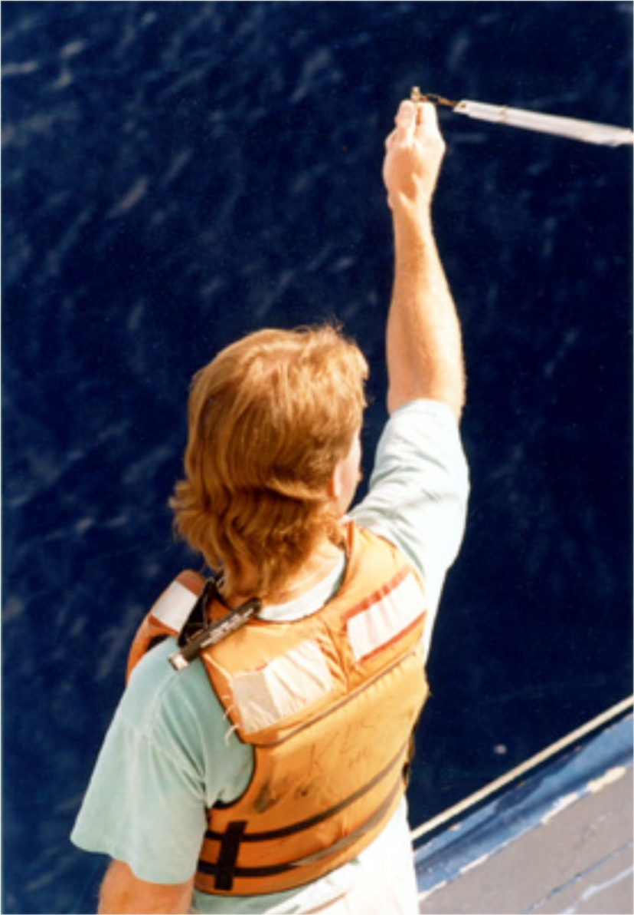
A Psychrometer
If the surrounding air is dry, more moisture evaporates from the wick, cooling the wet-bulb thermometer more so there is a greater difference between the temperatures of the two thermometers. If the surrounding air holds as much moisture as possible - if the relative humidity is 100% - there is no difference between the two temperatures.

Slide 8
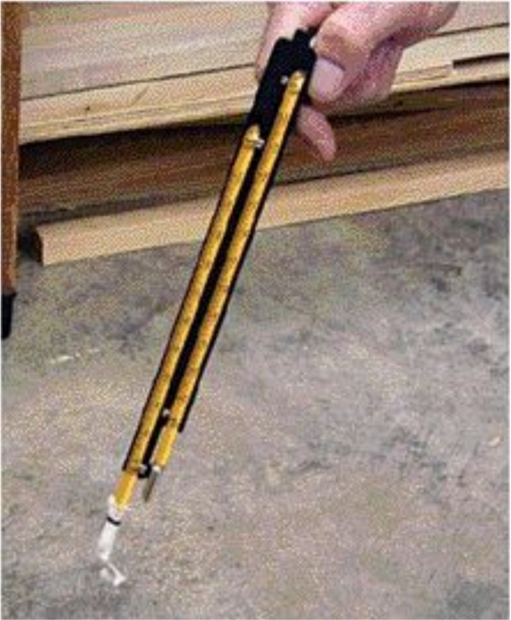
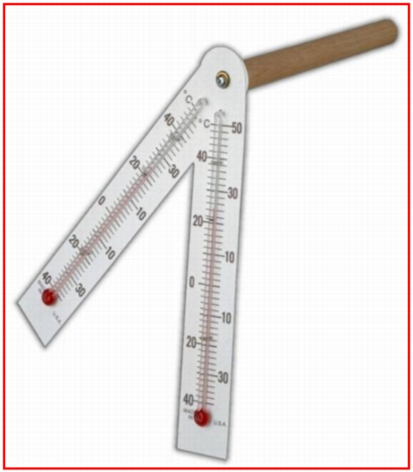
Psychrometers
One of these bulbs
should have a piece
of wet cheesecloth on it.
See the wet “wick”
on one of these bulbs.

Slide 9
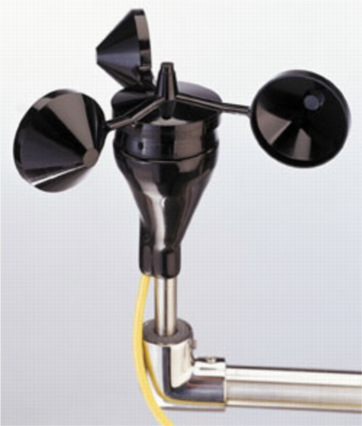
An Anemometer measures wind speed.
The cups catch the wind, turning a dial attached to the instrument. The dial shows the wind speed. Wind speed can be estimated without special tools by observation.

Slide 10
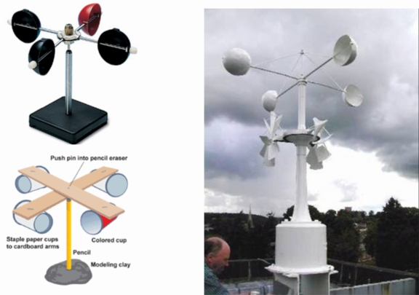
Anemometers

Slide 11
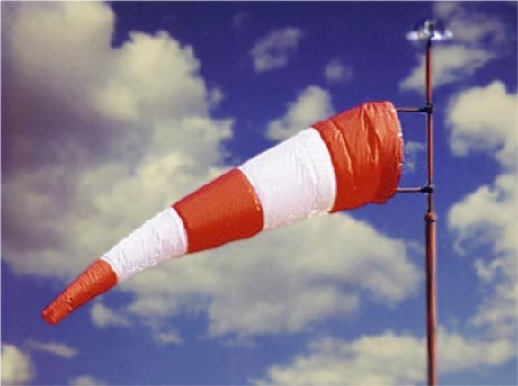
A Windsock is used at airports to indicate wind direction for takeoffs and landings.
They help the pilots select the proper runway so that they can take off and land into the wind.

Slide 12
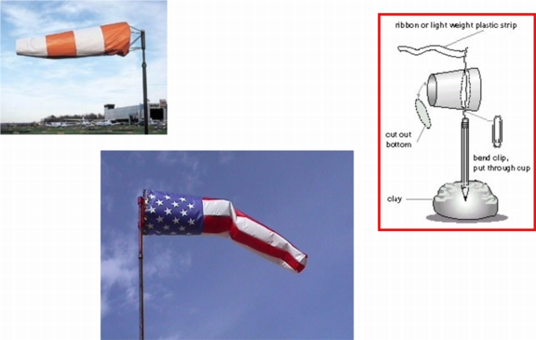
Windsocks

Slide 13
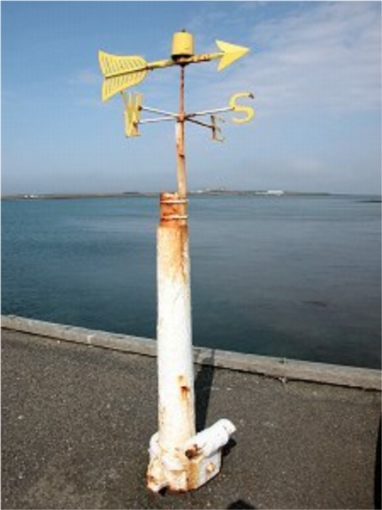
A Wind Vane is used to measure wind direction.
It spins on a rod and points in the direction from which the wind comes.

Slide 14
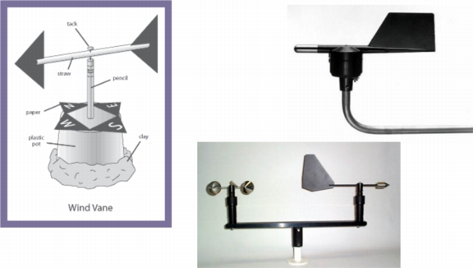
Wind Vanes
Most airport Wind Vanes have Anemometers also.

Slide 15
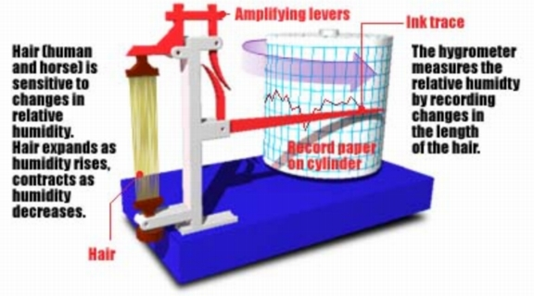
A Hygrometer is an instrument used to measure the humidity of the air.
A mechanical Hygrometer uses human or horse hairs which stretch as they absorb moisture.

Slide 16
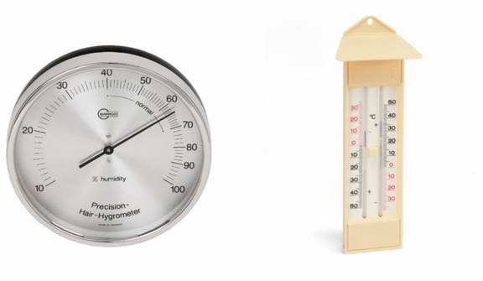
Hygrometers

Slide 17
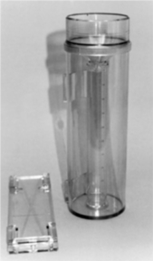
A Rain Gauge is used to measure amount of rainfall.
An official Rain Gauge consists of a large cylinder with a funnel and a smaller measuring tube inside.

Slide 18
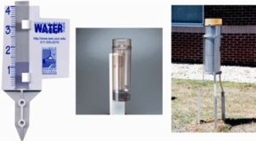
Rain Gauges

Slide 19
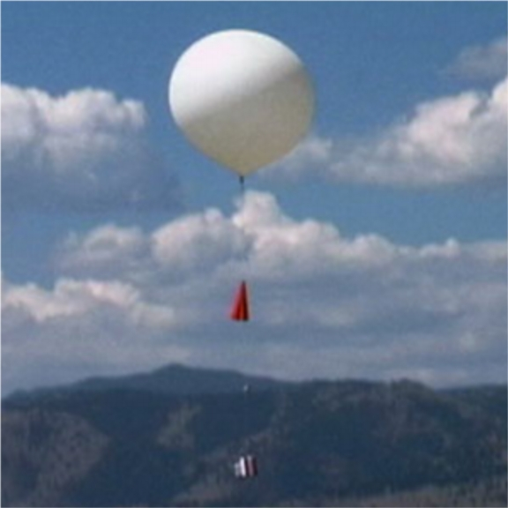
A Weather Balloon measures weather conditions higher in the atmosphere.
Measures temperature, air pressure, wind speed and direction

Slide 20
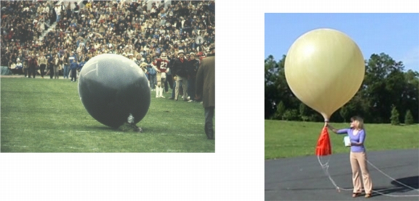
Weather Balloons
Sometimes weather balloons
land in the oddest places!

Slide 21
A Weather Satellite is able to photograph, track, and measure the conditions of large-scale air movements.
A meteorologist then compiles and analyzes the data with the help of computers.
NOAA weather satellite launched in 2005.

Slide 22
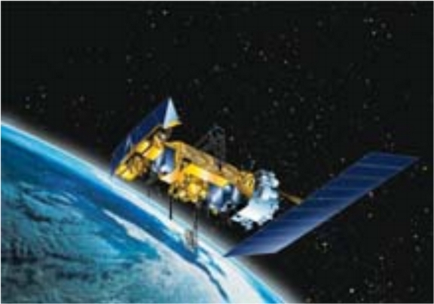
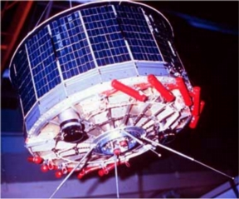
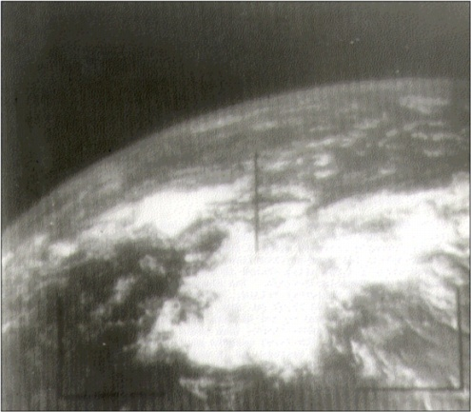
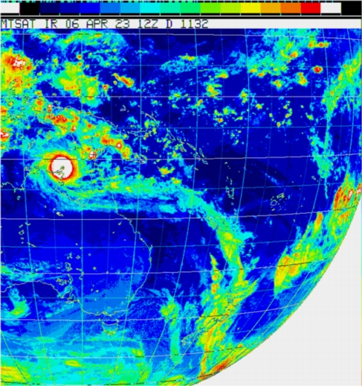
Weather Satellites
NOOA-M measures information about Earth
radiation, sea and land surface temperature,
atmospheric vertical temperature, water vapor,
and ozone in the troposphere and stratosphere.
Tiros 1 - 1965
Weather Satellite
Image
First usuable Tiros 1 image

Slide 23
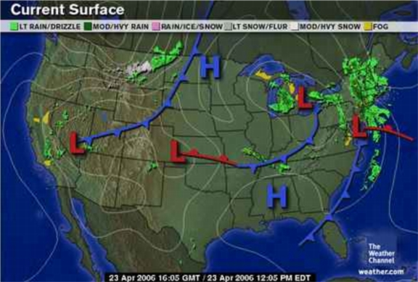
Weather Prediction
All these instruments are used by meteorologists to report the current
and predict the future weather.
The End.

